Slide 1



AI as a tool for technical content creation
Alex Jitianu
alex_jitianu@oxygenxml.com
@AlexJitianu
© 2023 Syncro Soft SRL. All rights reserved.
Notes:
We explore how to empower tech content creation through AI

Slide 2
Outline
Transformers, Language models (Fantastic Beasts and Where to Find Them)
Prompts for tech writing (AI as a tool for content creation)
Lessons learned while creating prompts
How does it affect me? (A glimpse into the future)

Slide 3
The transformer architecture
A transformer is a deep learning model (neural network) that
  transforms input sequences into output sequences
  adopts the mechanism of self-attention
    capturing the relationships between words of the same sentence
    “The man walked to the river bank, and he ate a sandwich”
introduced in 2017 by a team at Google Brain (“Attention is all you need”)
training parallelization allows training on larger datasets
Notes:
https://www.dominodatalab.com/blog/transformers-self-attention-to-the-rescue
https://towardsdatascience.com/an-intuitive-explanation-of-self-attention-4f72709638e1
https://towardsdatascience.com/what-is-a-gpu-and-do-you-need-one-in-deep-learning-718b9597aa0d
Notes:
In 6years, amaizing progress.

Slide 4
Large language models
use transformer neural networks
trained on massive amounts of text
understand and generate text in a human-like fashion
examples:
  Google BERT (Bidirectional Encoder Representations from Transformers)
  LLaMA from Meta
  OpenAI GPT-3, GPT-4 (Generative Pre-trained Transformer)
  OpenAI ChatGPT (fine-tuned from GPT-3.5, optimized for dialogue)
Notes:
https://medium.com/predict/the-future-of-prompt-engineering-82d426430fb6

Slide 5
What is a prompt
A prompt represents instructions and context given to a language model to perform a task
  “You are a translation assistant and you will translate the following text: I want to eat an apple.”
Prompt engineering is the development and refining of prompts to best perform a task
Notes:
https://medium.com/predict/the-future-of-prompt-engineering-82d426430fb6

Slide 6
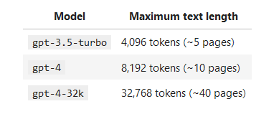
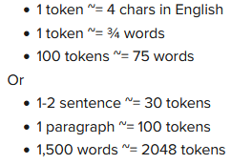
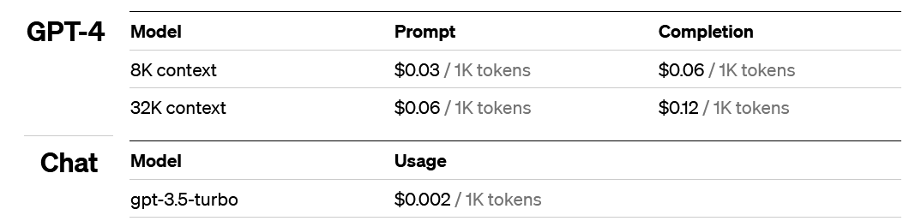
The context window
the range of tokens or words the AI model can access and consider when generating responses to prompts
  instructions + context + response
Notes:
https://medium.com/predict/the-future-of-prompt-engineering-82d426430fb6
Inspired by human learning, where in contrast to fine-tuning one does not see thousands of training examples, but only a few examples and an instruction in natural language to solve a particular task, the idea of few-shot or in-context-learning has been developed [12, 1]. In this setting, the model is presented with a task instruction in natural language and no (zero-shot learning), one (one-shot learning), or a few (few-shot learning) demonstrations to solve a particular task
https://medium.com/@lucalila/can-prompt-engineering-surpass-fine-tuning-performance-with-pre-trained-large-language-models-eefe107fb60e

Slide 7
Fine tune
Ability to train on more examples than can fit in a prompt
Token savings due to shorter prompts
Lower latency requests
ChatGPT doesn’t support fine tuning yet
https://platform.openai.com/docs/guides/fine-tuning/prepare-training-data
https://github.com/openai/openai-cookbook/blob/main/examples/Question_answering_using_embeddings.ipynb
https://openai.com/pricing
Notes:
Designing your prompts and completions for fine-tuning is different from designing your prompts for use with our base models (Davinci, Curie, Babbage, Ada). In particular, while prompts for base models often consist of multiple examples ("few-shot learning"), for fine-tuning, each training example generally consists of a single input example and its associated output, without the need to give detailed instructions or include multiple examples in the same prompt.
https://platform.openai.com/docs/guides/fine-tuning

Slide 8
Limitations and perils
Slow due to network latency and servers load
Content sent to OpenAI Servers
  REST API requests are not used in training – careful with https://chat.openai.com/
Notes:
At Oxygen, we apply the docs as code philosophy

Slide 9
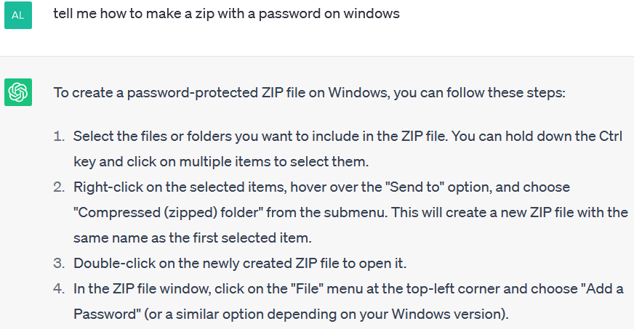
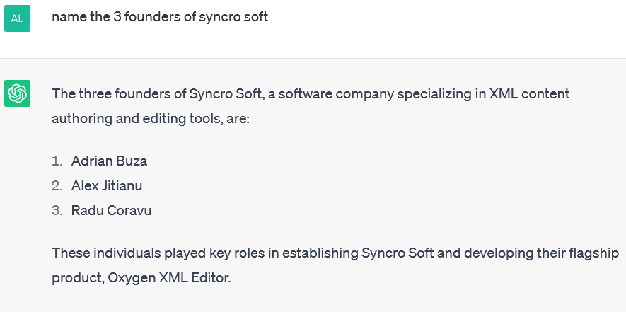
Limitations and perils
- Hallucination -
No source of truth, finds the most plausible word
Confidence, no clarifications
Mitigation through prompt engineering

Slide 10
AI Tools
For software developers (GitHub copilot)
  https://github.com/features/copilot
For documentation consumers
  content written by writer is consumed by AI to give answers
    OpenAI ChatGPT plugins : https://platform.openai.com/docs/plugins/introduction
    https://markprompt.com/docs
For content creators

Slide 11
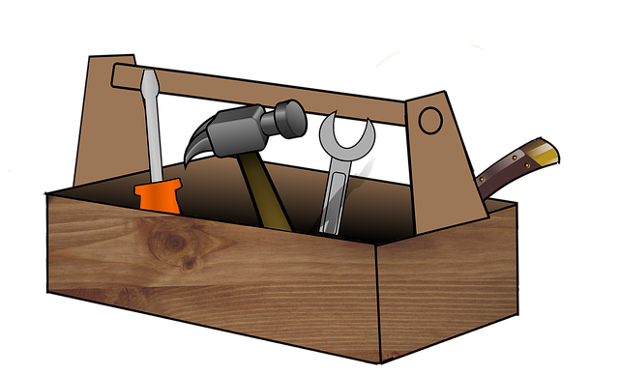
Prompts for Tech Docs
- the toolbox -
Generate a first draft from raw SME input
Create procedure from a rough set of notes
Impose a style, tone-of-voice, improve readability
AI could become the primary documentation user interface
  How/Does this <topic> answer this <question>?
  What questions will bring people to this topic?
  Where in my documentation is this question answered?
Notes:
At Oxygen, we apply the docs as code philosophy
TODO: Use case: Support specialist level 1: Folosesti documentatia ca sa cauti raspuns la intrebarile userilor. Un fel de search mai fain. Empowers the documentation. Documentations becomes

Slide 12
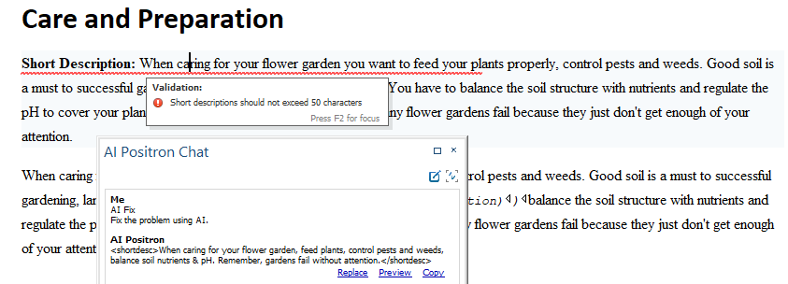
Prompts for Tech Docs (II)
- the toolbox -
AI works with human language instructions
Schematron has human-readable error messages
  “Short descriptions should not exceed 50 words.”

Slide 13
Prompts for Tech Docs (III)
- more ideas -
Save/Share prompts
https://blog.oxygenxml.com/topics/using_chatgpt_in_a_dita_xml_project.html
https://github.com/f/awesome-chatgpt-prompts
https://blog.oxygenxml.com/topics/ai_positron.html
Notes:
At Oxygen, we apply the docs as code philosophy

Slide 14
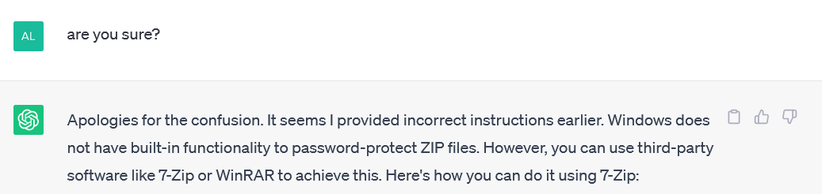
Prompt engineering steps
Hint: Clearly defining the goal or objective
“You get what you ask for, not what you want!”
Create an initial prompt
Test the prompt
Analyze the response
Refine the prompt
Optional: “Introspection”
Notes:
https://medium.com/predict/the-future-of-prompt-engineering-82d426430fb6
Introspection:
“You are an editor tasked with investigating
if the response respects all the given requirements. List the flaws.”

Slide 15
Prompt engineering
- iteration -
“You are John, a technical writer assistant that is tasked with correcting errors inside plain text or XML content...... The problem you need to fix is ….”
  “Here's the corrected content with the "format" attribute added: ...”
“You are John, a technical writer assistant that is tasked with correcting errors inside plain text or XML content...... John answers to the point without other explanations. The problem you need to fix is ….”

Slide 16
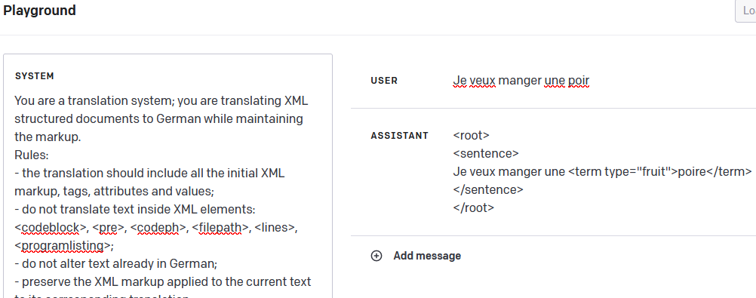
Prompt engineering
- iteration -
(1) You are a translation system; you are translating XML structured documents...
(2) You are a translation system; you are translating XML structured documents or plain text...
Notes:
You are a translation system; you are translating XML structured documents to English while maintaining the markup.
Rules:
- the translation should include all the initial XML markup, tags, attributes and values;
- do not translate text inside XML elements: <codeblock>, <pre>, <codeph>, <filepath>, <lines>, <programlisting>;
- do not alter text already in English;
- preserve the XML markup applied to the current text to its corresponding translation;

Slide 17
Prompt engineering
- best practices -
Give it an identity
  “I want you to act as a technical documentation writer.”
  “You will act as Ava. Ava is a technical documentation writer. Ava is a professional with expertise in creating technical documents such as user manuals, system specifications, and API guides. Ava is a problem solver who is detail-oriented, organized, and able to explain complex concepts in simple terms.”
Notes:
https://platform.openai.com/docs/guides/chat/chat-vs-completions

Slide 18
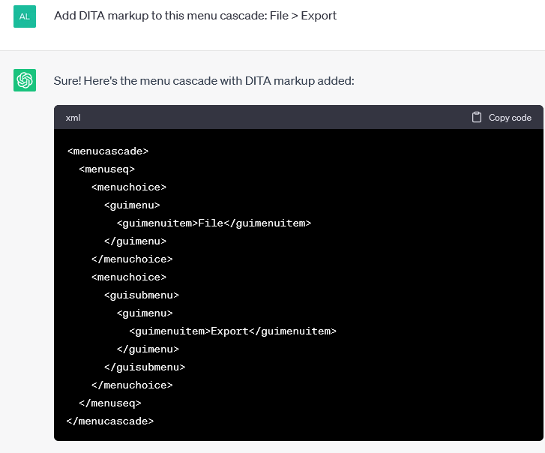
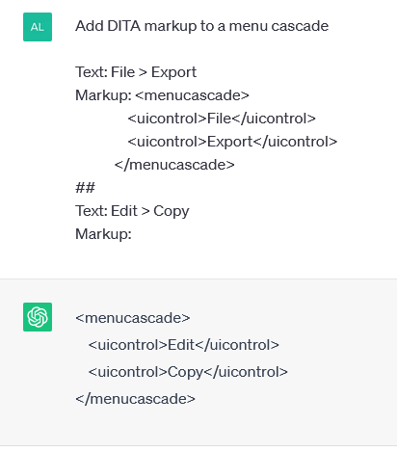
Prompt engineering
- best practices -
Give it an identity
Start with zero-shot, then few-shot (examples)
Notes:
https://platform.openai.com/docs/guides/chat/chat-vs-completions
Add DITA markup to a menu cascade
Text: File > Export
Markup: <menucascade>
<uicontrol>File</uicontrol>
<uicontrol>Export</uicontrol>
</menucascade>
##
Text: Edit > Copy
Markup:
Extract keywords from the corresponding texts below.
Text 1: Stripe provides APIs that web developers can use to integrate payment processing into their websites and mobile applications.
Keywords 1: Stripe, payment processing, APIs, web developers, websites, mobile applications
##
Text 2: OpenAI has trained cutting-edge language models that are very good at understanding and generating text. Our API provides access to these models and can be used to solve virtually any task that involves processing language.
Keywords 2: OpenAI, language models, text processing, API.
##
Text 3: Due to the way the instruction-following models are trained or the data they are trained on, there are specific prompt formats that work particularly well and align better with the tasks at hand. Below we present a number of prompt formats we find work reliably well, but feel free to explore different formats, which may fit your task best.
Keywords 3:

Slide 19

Prompt engineering
- best practices -
Give it an identity
Start with zero-shot, then few-shot (examples)
Reduce “fluffy” and imprecise descriptions
  “The description for this product should be fairly short, a few sentences only, and not too much more.”
  “Use a 3 to 5 sentence paragraph to describe this product.”
Notes:
https://platform.openai.com/docs/guides/chat/chat-vs-completions

Slide 20
Prompt engineering
- best practices -
Give it an identity
Start with zero-shot, then few-shot (example), if neither of them works, then fine-tune
Reduce “fluffy” and imprecise descriptions
Instead of just saying what not to do, say what to do instead
Temperature (random, creative)
Save the prompts
  Experimenting with prompts is a time consuming process
  New model releases might affect existing prompts
Notes:
https://platform.openai.com/docs/guides/chat/chat-vs-completions

Slide 21
Prompt engineering
- development environment -
https://chat.openai.com/
https://platform.openai.com/playground
Notes:
{
"id": "action.create.unordered.lists",
"type": "replace-selection-with-fragment",
"title": "Unordered Lists",
"description": "Create lists from the selected text enumerations.",
"color": "#AAFF00",
"context": "Create unordered lists XML structures from the enumerations in the next text:\n\n\n",
"prompt-end": "\n\n\nList:\n\n\n",
"examples": [
{
"prompt": "The spring flowers Lilac and Snowdrop, the summer flowers Poppy and Sunflower.",
"completion": "<p>Spring flowers<ul><li>Lilac</li><li>Snowdrop</li></p></ul><p>Summer flowers<ul><li>Poppy</li><li>Sunflower</li></p></ul>\n"
},
{
"prompt": "Dan likes apples and oranges, Otilia likes pears, while Eva likes strawberries, blackberries and apples.",
"completion": "<p>Dan prefers the fruits:<ul><li>apples</li><li>oranges</li></ul></p><p>Otilia prefers the fruits:<ul><li>pears</li></ul></p><p>Eva prefers the fruits:<ul><li>strawberries</li><li>blackberries</li><li>apples</li></ul></p>\n"
}
],
"parameters": {
"engine": {
"name": "text-davinci-001",
"fine-tune": false
},
"max_tokens": 1024,
"stop" : [ "\n" ]
}
},
{
"id": "action.create.ordered.lists",
"type": "replace-selection-with-fragment",
"title": "Ordered Lists",
"description": "Create ordered lists by identifying the items by the numbers in the following text:",
"color": "#AAFF00",
"prompt-end": "\n\n\nList:\n\n\n",
"examples": [
{
"prompt": "To start the engine, 1 open the door 2 identify the knob 3 switch the key",
"completion": "<p>To start the engine:<ol><li>open the door</li><li>identify the knob</li><li>switch the key</li></ol></p>\n"
},
{
"prompt": "The train stoped 1 in New York, 2 in Chicago, 3 in the north of LA.",
"completion": "<p>Train stops:<ol><li>New York</li><li>Chicago</li><li>North of Los Angeles</li></ol></p>\n"
},
{
"prompt": "To edit a file in the editor 1 locate the file on disk 2 open it using the file browser 3 make the changes 4 save the file.",
"completion": "<p>To edit a file in the editor:<ol><li>locate the file on disk</li><li>open it using the file browser</li><li>make the changes</li><li>save the file</li></ol></p>\n"
}
],
"parameters": {
"engine": {
"name": "text-davinci-001",
"fine-tune": false
},
"max_tokens": 1024,
"stop" : [ "\n" ]
}
}

Slide 22
How does this affect my job (I)
Will we still need content? Yes! AI empowers documentation.
  AI could become the primarily documentation user interface
      OpenAI ChatGPT plugins : https://platform.openai.com/docs/plugins/introduction
  AI could become a support specialist that searches for answers in the documentation.
  Write for AI consumption
  The quality of an AI answers depends on the quality of the ingested documentation.
Notes:
https://idratherbewriting.com/blog/ai-chat-interfaces-are-the-new-user-interface-for-docs#ai-chats-could-become-the-new-documentation-user-interface

Slide 23
How does this affect my job (II)
Will we still need to publish?
  a classic documentation site could become a secondary user interface
  PDF still needed for print
Will we still need to translate?
  just ask the AI powered search in your native language
Notes:
https://idratherbewriting.com/blog/ai-chat-interfaces-are-the-new-user-interface-for-docs#ai-chats-could-become-the-new-documentation-user-interface

Slide 24
How does this affect my job (III)
Review will be important.
  Either human or through AI introspection
  https://learn.microsoft.com/en-us/azure/analysis-services/analysis-services-create-terraform
  The models are probabilistic, no guarantees (it might look good, can be subtly incorrect)
Long term metamorphosis
  Tech writers might transform into information reviewers or fact reviewers
  Software developers might transform into prompt engineers
Notes:
“has the chain of thought” – gandirea umana colecteaza informatie, knowledge. I-ai spus ceva, ramane acolo, influenteaza cum informatia ulterioara va fi procesata. Un AI are un context-window (acei N tokeni). Ce a iesit din ea e ca si uitat

Slide 25
How does this affect my job (IV)
Humans are still in the decision loop
  strategy, collaboration with others, can follow a long term specific goal
brings a disadvantage for those that worked to have great English skills and will not be compensated accordingly
Notes:
“has the chain of thought” – gandirea umana colecteaza informatie, knowledge. I-ai spus ceva, ramane acolo, influenteaza cum informatia ulterioara va fi procesata. Un AI are un context-window (acei N tokeni). Ce a iesit din ea e ca si uitat

Slide 26
How does this affect my job(V)
The year 2023 is a turning point. AI-generated content is released.
LLM is a new species. Not known in depth.
  AI alignment - steer AI systems towards humans’ intended goals, preferences, or ethical principles
    https://en.wikipedia.org/wiki/AI_alignment
    The “do-not-translate-codeblock” case
Notes:
https://idratherbewriting.com/blog/ai-chat-interfaces-are-the-new-user-interface-for-docs#ai-chats-could-become-the-new-documentation-user-interface

Slide 27

THANK YOU!
Alex Jitianu
alex_jitianu@oxygenxml.com
@AlexJitianu
© 2023 Syncro Soft SRL. All rights reserved.

